Slide 1

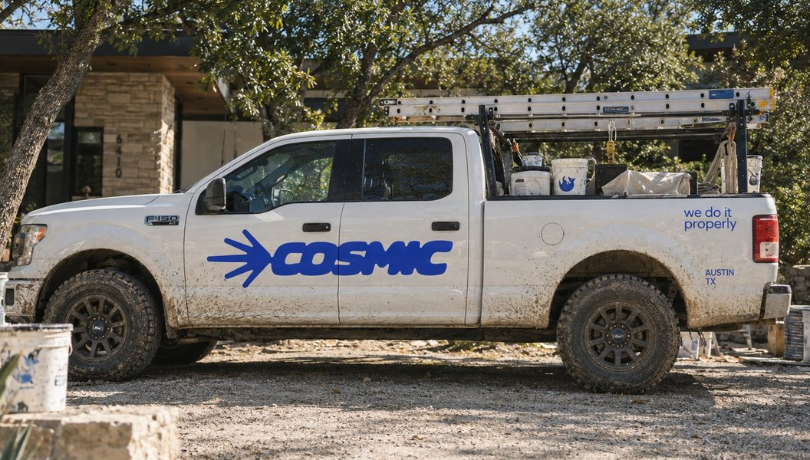

NEW LOOK
[TBC: LAUNCH DATE]
NEW LOOK.
SAME CREW.
Cosmic has a fresh identity. The people and the standard behind it are the ones you already know.
A NOTE FROM US
You've trusted us with your places, so you should hear this from us first: Cosmic looks different now. A new logo, new colours, new uniforms, a new website.
What hasn't moved is how we work. Same crew, same standard, still owner-led, still here for the long haul.
Roberto Martínez
Carlos R. Estrada
CO-FOUNDER
CO-FOUNDER
AT A GLANCE
WHAT'S NEW
WHAT STAYS
The logo and the colours.
The crew you know.
The uniforms and the truck.
The standard of the work.
Arlo, the newest member of the crew.
Owner-led, from first call to final walk-through.
The website.
CLARITY
CRAFT
No surprises.
Do it properly.
CARE
COMMIT
Leave it better.
See it through.
WE CARE, IT SHOWS.
HAVE A PROJECT IN MIND?
Get a clear estimate
choosecosmic.com
(512) 348-6433 · (512) 348-6232
2301 W Anderson Ln , Austin, TX 78757
[TBC: SUITE]
[TBC: HANDLE]
Notes:
rebrand/01-email-rebrand

